Slide 1
Band A Senior Advisers & Principal Analysts Implementation Unit
Candidate Pack
Closing date: Sunday 18th February23:55

Slide 2
Welcome
Page 3
About the Implementation Unit
Pages 4 - 6
Our people
Pages 7 - 12
Vacancy description & recruitment process
Pages 13 - 20
Indicative timeline
Page 21
Terms, conditions and benefits
Page 22

Slide 3
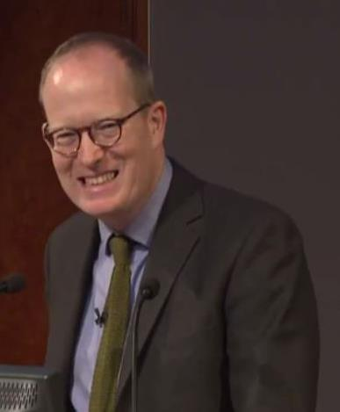
WELCOME
ABOUT THE IMPLEMENTATION UNIT
OUR PEOPLE
VACANCY DESCRIPTION & RECRUITMENT PROCESS
INDICATIVE TIMELINE
TERMS, CONDITIONS & BENEFITS
Thank you for your interest in the Implementation Unit.
We are a small Unit with significant and exciting responsibilities, supporting the top-decision makers in government, including the Prime Minister, senior Ministers, the Cabinet Secretary and the Chief Executive of the Civil Service. We work on the Government’s delivery priorities, collaborating closely and openly with Whitehall departments and major external stakeholders.
As a team, we place a very strong priority not just on what we do but how we do it. The IU Values (found on page 5) are at the heart of what we do and represent the spirit of how we work. To underpin what we do, we have developed the Implementation Leader framework of characteristics, built on the pillars of leadership, communication and problem solving: these also inform both our group and individual development.
I hope you will consider joining us and I wish you every success with your application.
James Quinault
Director, Implementation Unit

Slide 4
WELCOME
ABOUT THE IMPLEMENTATION UNIT
OUR PEOPLE
VACANCY DESCRIPTION & RECRUITMENT PROCESS
INDICATIVE TIMELINE
TERMS, CONDITIONS & BENEFITS
About the Implementation Unit
Established in 2012, the Implementation Unit is part of the Cabinet Office.
The Purpose of the Cabinet Office is:
To maintain the integrity of the Union, co-ordinate the security of the realm and sustain a flourishing democracy;
to support the design and implementation of HM Government’s policies and the Prime Minister’s priorities; and
to ensure the delivery of the finest public services by attracting and developing the best public servants and improving the efficiency of government.
The Implementation Unit works on behalf of the Prime Minister, the First Secretary of State and the Cabinet Secretary to:
Track the delivery of the PM’s priority policies and the wider Government programme: we do this by working with Departments to ensure they have robust plans with clear objectives, timetables and metrics, monitoring delivery against those plans, providing regular updates to the Prime Minister, and ensuring that the Implementation Task Forces have the information required to track and drive progress on cross-cutting issues.
Intervene where delivery or operational performance is at risk or progress is unclear: we do this through undertaking targeted projects and reviews (including deep dive reviews) supported by robust analysis and frontline intelligence to understand the progress of delivery, identify barriers to implementation, and develop solutions.
Strengthen implementation capability across the Civil Service: we do this by modelling good practice in our work, providing training to the professions and departments to increase their understanding and application of our implementation tools and techniques, and through the network of Implementation Units in departments.

Slide 5
WELCOME
ABOUT THE IMPLEMENTATION UNIT
OUR PEOPLE
VACANCY DESCRIPTION & RECRUITMENT PROCESS
INDICATIVE TIMELINE
TERMS, CONDITIONS & BENEFITS
Implementation Unit’s Values
In order to deliver these objectives, and make sure the Implementation Unit is a fulfilling and inclusive place to work, we have defined a set of core values:
1
We invest in building strong relationships across the centre but crucially with departments and wider delivery organisations, never forgetting it is they who do the actual delivery.
2
We are driven by the evidence ensuring the Implementation Unit’s advice is always objective, of high quality and underpinned by our robust analysis of data and frontline intelligence.
3
We focus our efforts on the highest priorities and where we will add most value.
4
We put the development of our people at the heart of all we do to empower everyone to achieve excellence.
5
We value and support each other, harnessing our diverse backgrounds, skills and experience, and embracing a feedback culture, to become greater than the sum of our parts.

Slide 6
WELCOME
ABOUT THE IMPLEMENTATION UNIT
OUR PEOPLE
VACANCY DESCRIPTION & RECRUITMENT PROCESS
INDICATIVE TIMELINE
TERMS, CONDITIONS & BENEFITS
Our commitment to a diverse and inclusive workplace
The Cabinet Office and the Implementation Unit are committed to being a diverse and inclusive workplace which also promotes health and wellbeing
The Cabinet Office aims to become a role model for not only the whole Civil Service, but also for employers everywhere, where we lead by example to show diversity is integral for a skilled, innovative and creative working environment – an environment that best serves the public. We are committed to playing our part in delivering the cultural change needed to help the Civil Service meet its ambition to be the most inclusive employer in the UK.
Having a truly diverse and inclusive workplace is important to us. This means embracing difference, spreading our net as wide as possible – and being inclusive, as well as diverse, so that everyone feels they are treated fairly and given the same opportunities to excel.
All Cabinet Office staff have access to staff networks that work to improve diversity and inclusion including:
Gender Equality Network
LGBT+ Network
Ethnic Minority Community
Carers’ Network (CANCARE)
ABLE (Part of Disability Confident)
Flexible Working Network
Wellwork
Christian Network
In addition, to help ensure the well-being of all our staff, the Cabinet Office operates a confidential listening service.

Slide 7
WELCOME
ABOUT THE IMPLEMENTATION UNIT
OUR PEOPLE
VACANCY DESCRIPTION & RECRUITMENT PROCESS
INDICATIVE TIMELINE
TERMS, CONDITIONS & BENEFITS
Our people
Your development matters to us
We recognise the importance of supporting the development needs of all our people. Our staff come from different backgrounds and with a wide range of skills and experience, making the IU a fantastic place to learn, both on the job and from each other. As well as learning through the challenging work you will face in your day-to-day life in the IU, we provide a comprehensive in-house development offer that is focused on developing your skills for the job and preparing you for the next stage of your career.
When you join the team: within your first week you will have two induction sessions, supported by a new joiner pack and you will be supported through your first weeks by a ‘Buddy’. Within your first few months, you will attend a five day “Implementation Basecamp”, designed to introduce you to the tools, techniques and approaches you will need to use during your time in the Unit.
Ongoing: you will work with your line manager to produce a personalised development plan to make sure your development needs and objectives are identified and an appropriate plan is put in place. Along with this we encourage an open and honest feedback culture both between managers and staff and at a peer to peer level.
All of this is underpinned by access to activities and resources such as:
IU Development Cohorts: groups of 10-11 people from across the Unit that undertake learning activities together;
Implementation Experts series: monthly talks by senior leaders who share their knowledge and experience of implementing inside and outside the Civil Service;
Implementation learn-ins: a quarterly half-day event for all staff to reflect on their development needs;
“How to” guides: a beginner's guide for people that need to know the basics;
Peer to peer sessions: one hour classes where IU staff share their knowledge and experience with the Unit on specific areas of expertise;
“Basecamp plus” sessions: intensive courses that will help colleagues become experts in a specific area;
Wider Civil Service learning : Access to a wider range of course, material, e-learning, talks by leading experts and networking events.

Slide 8
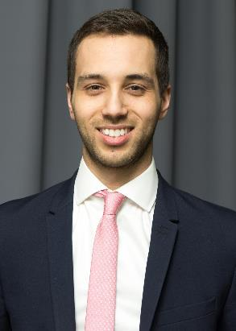
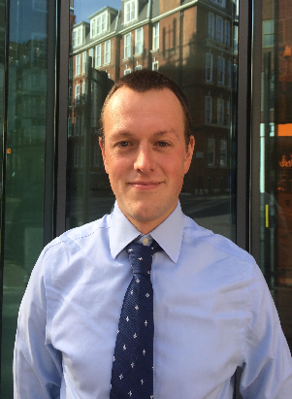
WELCOME
ABOUT THE IMPLEMENTATION UNIT
OUR PEOPLE
VACANCY DESCRIPTION & RECRUITMENT PROCESS
INDICATIVE TIMELINE
TERMS, CONDITIONS & BENEFITS
Our people
Our alumni frequently describe their time with us as one of the best jobs they have ever had. This is demonstrated by the commitment of our previous staff who continue to attend our events and help provide training and expertise to our current team members.
The next few pages describe the experiences of some of our past and present team members. We hope this will give you a flavour of what the Implementation Unit does and what attracted them to the Unit.

Slide 9
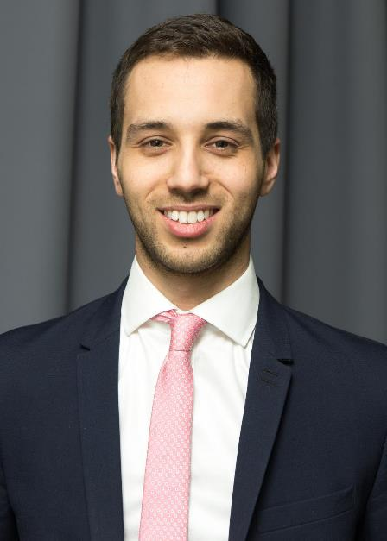
WELCOME
ABOUT THE IMPLEMENTATION UNIT
OUR PEOPLE
VACANCY DESCRIPTION & RECRUITMENT PROCESS
INDICATIVE TIMELINE
TERMS, CONDITIONS & BENEFITS
Fred, a former member of the IU
I work in the Ministerial Strategy Directorate at the Department for International Trade. I have just returned from an assignment in New York supporting the Permanent Secretary but I previously focused on government policy for supporting UK firms to invest overseas.
I worked as a Senior Adviser in the Implementation Unit, leading on growth and migration policy.
I learnt an incredible amount while at the Implementation Unit, not only professionally – as an economist and member of the implementation profession – but on the inner workings of central government. It really is an unparalleled platform from which to work with ministers and the most senior civil servants.

Slide 10
WELCOME
ABOUT THE IMPLEMENTATION UNIT
OUR PEOPLE
VACANCY DESCRIPTION & RECRUITMENT PROCESS
INDICATIVE TIMELINE
TERMS, CONDITIONS & BENEFITS
Maria, a current member of the IU
I am an analyst mainly working in the health space. My current work is delivering actionable insight for improving A&E waiting times next winter. I am using machine-learning techniques and a large amount of varied data that the NHS collects to predict performance and model different scenarios.
My main reason for applying to the IU was that I wanted to use my analytical skills to improve the quality of public services. I love working with new and rich datasets and the IU has offered opportunities to work with these across a wide variety of policy areas. I have also learnt a lot about how government works in the process.
Working in the IU means that I have a lot of access to ministers, meaning that I am able to present my work to people with the influence and power to make real changes.

Slide 11
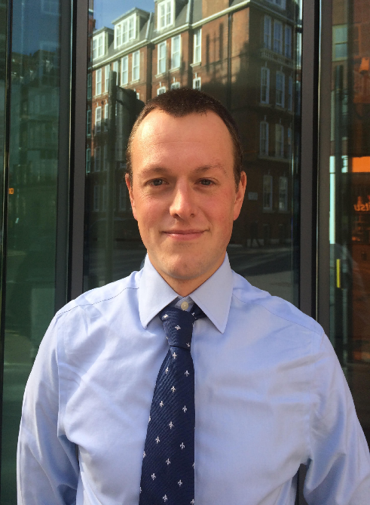
WELCOME
ABOUT THE IMPLEMENTATION UNIT
OUR PEOPLE
VACANCY DESCRIPTION & RECRUITMENT PROCESS
INDICATIVE TIMELINE
TERMS, CONDITIONS & BENEFITS
Laurie, a current member of the IU
I spend most of my time working on Universal Credit, which is radically changing the way that benefits are paid to hundreds of thousands of claimants. I have learnt a lot from working on this complex, high-profile programme.
Crucially, I have had the opportunity to put the skills I learnt at the IU Base Camp to the test by getting out into the field and conducting a Deep Dive on a particular issue relating to UC. Doing the research required everything from number-crunching and modelling data through to speaking to front-line staff and claimants. This culminated in a presentation to DWP's ministers and senior officials which, I must say, was a learning experience like no other.
I wanted to join the IU for three reasons: the opportunity to work on Government's top priorities; the expectation that you'll do both analytical and policy work; and the IU's reputation for recruiting some of the brightest and best from both in and outside government. I can honestly say it hasn't disappointed on any of these fronts.

Slide 12
WELCOME
ABOUT THE IMPLEMENTATION UNIT
OUR PEOPLE
VACANCY DESCRIPTION & RECRUITMENT PROCESS
INDICATIVE TIMELINE
TERMS, CONDITIONS & BENEFITS
Louisa, a current member of the IU
I first came across the Implementation Unit when I was working in a ministerial private office on Downing Street. My Minister relied on its work as it gave him a comprehensive understanding of complex and important issues based on front line intelligence and rigorous analysis.
Working in the private office, I enjoyed working with the Implementation Unit as it's filled with highly competent and passionate individuals. After shadowing the team on several deep dives I decided the Implementation Unit was where I wanted to work next because it combines some of the things I love about working in the centre of government with some of the things I miss about delivering front line services.
I joined the Implementation Unit last year and have worked on a range of high profile issues such as welfare and social mobility.

Slide 13
WELCOME
ABOUT THE IMPLEMENTATION UNIT
OUR PEOPLE
VACANCY DESCRIPTION & RECRUITMENT PROCESS
INDICATIVE TIMELINE
TERMS, CONDITIONS & BENEFITS
Vacancy description and recruitment process
Vacancy description – Senior Advisers
The Implementation Unit is looking to recruit Senior Advisers at Band A (G6/7 equivalent). These opportunities are open to external applicants as well as existing civil servants.
Senior Advisers lead a policy area on behalf of the Implementation Unit, working closely with a team of colleagues and reporting directly to a Senior Civil Servant. For their policy area, Senior Advisers are typically expected to:
Lead relationships with key departments across government to support implementation of the Prime Minister’s priorities and the wider Government programme
Build strong networks across departments and the centre of Government.
Develop detailed expertise to allow you to understand issues around frontline delivery as well as the bigger picture and political intent.
Monitor policy implementation and ask critical questions in order to proactively identify risks and potential solutions, including through informal relationships and more formal governance (e.g. Implementation Task Forces).
Lead implementation projects
Scope and plan implementation projects.
Conduct high quality quantitative and qualitative analysis, including fieldwork, to develop new insights on priority issues.
Draft convincing recommendations and present them to Number 10, Ministers and Senior Civil Servants.
Contribute to the Implementation Unit and wider Civil Service capability development programme
Help spread implementation capability and other relevant skills to IU colleagues and civil servants across Whitehall through training sessions.
Assist the IU’s development programme by contributing to the development of new learning and development material.

Slide 14
WELCOME
ABOUT THE IMPLEMENTATION UNIT
OUR PEOPLE
VACANCY DESCRIPTION & RECRUITMENT PROCESS
INDICATIVE TIMELINE
TERMS, CONDITIONS & BENEFITS
Vacancy description and recruitment process
Vacancy description – Principal Analysts
The Implementation Unit is looking to recruit Principal Analysts at Band A (G6/7 equivalent) with backgrounds in economics, statistics, operational research, social research or data science . These opportunities are open to external applicants as well as existing civil servants
Principal Analysts lead analysis across a portfolio of policy areas (including Housing, Health, Migration, Modern Slavery, Justice, Welfare, Employment, Skills, Education and the Industrial Strategy) on behalf of the Implementation Unit, working closely with a team of colleagues and reporting directly to the Chief Analyst or Deputy Chief Analyst. For their policy areas, Principal Analysts are typically expected to:
Lead analysis for implementation projects
Scope and plan analysis for implementation projects.
Conduct high-quality quantitative analysis, to develop new insights on priority issues.
Contribute to high-quality qualitative analysis, including fieldwork.
Draft convincing recommendations and present them to Number 10, Ministers and Senior Civil Servants.
Lead relationships with key analysts across government to support implementation of the Prime Minister’s priorities and the wider Government programme
Build strong networks with analysts and policy colleagues across departments and the centre of Government.
Develop detailed expertise to allow you to understand issues around frontline delivery, as well as the bigger picture and political intent.
Monitor policy implementation and ask critical questions in order to proactively identify risks and potential
solutions, in both informal relationships and more formal governance (e.g. Implementation Task Forces).
Contribute to the Implementation Unit and wider Civil Service capability development programme
Help spread implementation capability and other relevant skills to IU colleagues and civil servants across Whitehall through training sessions.
Assist the IU’s development programme by contributing to the development of new learning and development material.
14

Slide 15
WELCOME
ABOUT THE IMPLEMENTATION UNIT
OUR PEOPLE
VACANCY DESCRIPTION & RECRUITMENT PROCESS
INDICATIVE TIMELINE
TERMS, CONDITIONS & BENEFITS
Vacancy description and recruitment process
Band A - Head of Implementation Capability & Practice
The Implementation Unit is also looking to recruit a Head of Implementation Capability & Practice at Band A (G6/7
equivalent). This opportunity is open to external applicants as well as existing civil servants. This role will be appointed
from successful candidates for the Senior Adviser role.
You will be responsible for:
Leading the Implementation Unit’s work on building and improving implementation capability in the Civil Service both by awareness raising and use of common tools and good practice.
Leading the embedding and ongoing delivery of a sustainable learning and performance culture within the IU, that is both unique yet targeted. This includes developing new and innovative ways of delivering capability and development across the Unit, taking into account diversity and inclusion as well as cementing our relationship with London Business School and Bradford University to provide learning in both directions for a diverse group of staff and students.
Leading the relationship between the Implementation Unit and Departmental Implementation Units to establish clear quality and good practice standards across the implementation family.
Identify best practice and use findings to create innovative and compelling new learning and development offerings
To achieve this you will line manage a B2 Implementation Capability Adviser.

Slide 16
WELCOME
ABOUT THE IMPLEMENTATION UNIT
OUR PEOPLE
VACANCY DESCRIPTION & RECRUITMENT PROCESS
INDICATIVE TIMELINE
TERMS, CONDITIONS & BENEFITS
Vacancy description and recruitment process
A typical ‘day in the life’ of a Senior Adviser or Principal Analyst
Senior Advisers and Principal Analysts conduct a variety of tasks across their policy area, and beyond. In addition to monitoring and project activity, they often respond to ad hoc requests, based on ministerial enquiries and urgent events.
While there is no such thing as a typical day, Senior Advisers and Principal Analysts frequently spend their time:
drafting or commenting on advice to the Prime Minister or senior Ministers and officials;
organising or undertaking fieldwork to understand frontline delivery;
preparing or running a workshop with stakeholders or departmental colleagues;
attending a departmental meeting] to discuss performance or one of our “deep dives”
meeting No10 / HM Treasury / Cabinet Office colleagues;
meeting key external stakeholders in their policy area (e.g. third sector organisations);
working with departments to obtain and analyse data;
supporting the Strategy and Performance team in tracking the Government’s programme;
preparing a performance pack for an Implementation Task Force;
drafting the scope for a potential deep dive;
writing up deep dive findings;
ensuring the analysis is communicated in a compelling, persuasive, accurate and user-friendly way;
working on personal development by attending or delivering an IU peer to peer session; and
attending expert talks.

Slide 17
WELCOME
ABOUT THE IMPLEMENTATION UNIT
OUR PEOPLE
VACANCY DESCRIPTION & RECRUITMENT PROCESS
INDICATIVE TIMELINE
TERMS, CONDITIONS & BENEFITS
Vacancy description and recruitment process
Recruitment process
We recruit our candidates at Band A through the Implementation Unit’s Selection Centre. This includes exercises that reflect and test our core skills. Candidates will be assessed purely on their performance against the nine Implementation Leader Characteristics (Annex A) during the exercises. We use this process so we can make a fair and objective assessment of the experience and skills candidates bring. It is also an opportunity for candidates to get a feel for the work we do and to meet some of our staff and the Senior Leadership Team.
The Selection Centre is an all day event and consists of a number of exercises; these include: a group exercise, a panel interview, an analytical exercise and a written exercise. A summary of each exercise is set out below:
Group exercise
The group exercise will focus on a question from a Minister, relating to a specific area of government policy, that your group has been asked to answer. During this time you will have to read the information, discuss issues with others in a meeting format and reach a conclusion. Group members are regarded as equal and groups are told not to appoint someone to chair the meeting. Not only will you be expected to present a strong case, you will also need to listen to what the other candidates have to say and then negotiate to come to an agreed position.
Panel interview
The panel interview will allow you to set out why you want to work in the Implementation Unit, as well as asking you to provide evidence about how you meet the Implementation Leader characteristics. You will be asked to provide evidence from previous roles you have undertaken and to set this out using the Situation, Task, Action and Result approach, with emphasis on what you contributed personally. Principal Analysts will also be asked to give a 5-minute presentation on an example of your analysis, and answer questions on it: the title of the presentation will be provided in advance, alongside your invitation to the Selection Centre. All other aspects of the Selection Centre are the same for Senior Advisers and Principal Analysts.

Slide 18
WELCOME
ABOUT THE IMPLEMENTATION UNIT
OUR PEOPLE
VACANCY DESCRIPTION & RECRUITMENT PROCESS
INDICATIVE TIMELINE
TERMS, CONDITIONS & BENEFITS
Vacancy description and recruitment process
Analytical exercise
This will test your numerical and analytical skills and ability to use Excel. You will be asked to use the information provided to produce a chart or graph with commentary. You will be required to explain the process that you followed and to show your workings.
Written exercise
The written exercise will test your ability to construct a short briefing note which summarises a diverse range of information provided to you. You will be provided with a number of documents from a variety of sources. Your task will be to analyse the papers and prepare a briefing note for the Minister. The important thing is how you support your conclusions using the facts provided, and how you express this in writing.
Selection Centre – stage two
If you score sufficiently highly at the Selection Centre you will be invited to a follow-up session with the whole of the IU Senior Leadership Team, involving a presentation task and closing interview questions.
Presentation exercise
For the presentation exercise you will be given 30 minutes to prepare a 10-minute presentation. The panel will then follow-up with 10 minutes of Q&A.

Slide 19
WELCOME
ABOUT THE IMPLEMENTATION UNIT
OUR PEOPLE
VACANCY DESCRIPTION & RECRUITMENT PROCESS
INDICATIVE TIMELINE
TERMS, CONDITIONS & BENEFITS
Vacancy description and recruitment process
How to apply
All applicants need to outline, in no more than a total of 250 words for each competence, examples of when they have exhibited each of the following Implementation Leader characteristics (see Annex A for details):
Leader: shows an ability to inspire by driving delivery, including through others
Communicator: challenged ideas and convinced others to change
Problem solver: uses analytical and creative problem solving techniques to provide thoughtful, well-timed solutions
Analysis: (for Principal Analysts only) what specialist skills and experience qualify you for the position
of Principal Analyst?
Principal Analyst roles are open to Economists, Statisticians, Operational Researchers, Social Researchers and Data Scientists.
A paper sift will be carried out on Thursday 22nd February 2018 and we plan to inform candidates of the result in the days following to allow you to prepare for the Selection Centre, if you are successful.
In line with Civil Service policy, please note that the recruitment will be ‘name-blind'. We ensure that people will be judged on merit and not on their background, race or gender. This is helped further by removing the candidate’s name and other personal information, such as their nationality and education details, before the written applications are sifted
The Selection Centre is due to take place on Monday 5th March and Tuesday 6th March 2018 in central London and you will need to be available between 8:45am and 5.00pm on your allocated day. For those selected to go forward to stage two, this will take place on Friday 9TH March 2018 and you will be allocated a time slot between 9.00am and 5.00pm.

Slide 20
WELCOME
ABOUT THE IMPLEMENTATION UNIT
OUR PEOPLE
VACANCY DESCRIPTION & RECRUITMENT PROCESS
INDICATIVE TIMELINE
TERMS, CONDITIONS & BENEFITS
Vacancy description and recruitment process
How to apply
We will also be holding an informal “open evening” on Thursday 8th February from 5.30pm – 7.30pm. This is an opportunity to hear from the Senior Leadership Team on the work of the Unit along with a chance to speak to team members about their experiences. If you are interested in attending this event please express your interest and sign up for open evening via the link below.
https://www.eventbrite.com/e/implementation-unit-recruitment-open-evening-tickets-42494115042
Please note this is an informal event and will not form part of the recruitment or selection process.
To discuss these opportunities further, please contact Chantelle Lyon at chantelle.lyon@cabinetoffice.gov.uk

Slide 21
WELCOME
ABOUT THE IMPLEMENTATION UNIT
OUR PEOPLE
VACANCY DESCRIPTION & RECRUITMENT PROCESS
INDICATIVE TIMELINE
TERMS, CONDITIONS & BENEFITS
Indicative Timeline
Date | Activity
Thursday 8th February 17:30-19:30 | IU Open Evening at 35 Great Smith Street, London SW1P 3BQ
Sunday 18th February 23:55 | Deadline for applications
Thursday 22nd February | Paper sift
Friday 23rd February | Applicants notified of sift results
Monday 5th / Tuesday 6th March | Selection Centre Stage 1 Venue to be communicated to attendees
Wednesday 7th March | Applicants notified of results
Friday 9th March | Selection Centre Stage 2 at 35 Great Smith Street, London SW1P 3BQ
Wednesday 14th March | Applicants notified

Slide 22
WELCOME
ABOUT THE IMPLEMENTATION UNIT
OUR PEOPLE
VACANCY DESCRIPTION & RECRUITMENT PROCESS
INDICATIVE TIMELINE
TERMS, CONDITIONS & BENEFITS
Terms, conditions and benefits
Contract
The role is offered as a permanent Cabinet Office contract to non-civil servants. Secondments of up to one year are also available to applicants from consultancy practices, subject to agreement.
For existing civil servants, successful candidates would join the Cabinet Office on loan from their home department for a period of between 2-3 years. If you are successful on promotion there is an expectation that your home department will honour your promotion when you return.
You must obtain your home department’s agreement to you going on loan to Cabinet Office before you submit your application.
Salary
The Implementation Unit’s salary offer will fall within the relevant Cabinet Office pay band (Band A, Grade 6/7 equivalent - £48,480 to £60,484). Annual salary increases will depend upon individual performance and contribution to the organisation’s success. In addition there will be the opportunity to earn performance related bonuses.
There is an expectation that successful applicants new to the Civil Service will join on the pay band minimum. Existing civil servants on loan from their home department retain their existing terms and conditions including salary.
Terms and conditions
Further details on terms and conditions are provided in the job specification available at: https://www.civilservicejobs.service.gov.uk.

Slide 23
ANNEX A: Implementation Leader Characteristics
Leader |  | Communicator |  | Problem Solver
Passion to drive change Delivers results at pace and makes things better Delegates and drives delivery through others by capitalising on strengths Committed to push the boundaries because it matters |  | Wants to continuously learn and develop Eagerly transmits and receives knowledge Proactively helps others to learn and develop |  | Self starter Seeks out new and different information that drives priorities, and doesn‘t wait to be asked Dares to be different and is not afraid to innovate
Ability to inspire Creates a compelling vision and sees it through Translates complex issues into simple, focused actions A team player, who enjoys being part of a team, can take different roles in a team or lead a team, but is not driven by status |  | Connects with a range of people Empathises and is not patronizing / intimidating, with a self awareness of impact on others Credible, builds and maintains trust by being engaging and personable – not arrogant or aggressive Actively listens to others but is not afraid to have difficult conversations |  | Applies logical thinking with political awareness Provides thoughtful and well timed solutions Pragmatic and adaptable not driven by process, flexible and can cope with uncertainty/ambiguity Applies political judgement, knowing when to push for more, when to escalate and when to take a different approach
Resilience Confident without attitude Stays cool under pressure, deals with setbacks and crisis positively Persuades and influences others to buy into change but feels comfortable taking the tough choices |  | Challenges ideas Seeks more information, doesn't take things at face value Challenges on an equal footing, grounded in evidence Courage and determination to convince others to change |  | Focuses on impact Looks beyond the immediate task and considers objectives Creative, inquisitive and thinks outside the norm to get results and doesn‘t just take the easiest options Will not compromise on quality

Slide 25
Band A Senior Advisers and Principal Analysts, Implementation Unit – January 2018 Candidate Pack

